Slide 1

Office of Small Business Affairs
Macon-Bibb County
Charles L. Coney, Interim County Manager, Operations
Julie Moore, Interim County Manager, Finance
Dr. James Louis Bumpus, Director
Small Local Business Enterprise Program
Explanation
May 9, 2017

Slide 2

SMALL LOCAL BUSINESS ENTERPRISE PROGRAM
LOCAL SMALL BUSINESS SCHEDULE OF SIZE STANDARDS AND ELIGIBILITY
a. The SLBE must not have employed more than fifty (50) full-time employees at any one time during the last three years; and
b. The SLBE must have annual gross revenues within its largest primary NAICS commodity code as averaged over its most recent past three fiscal years of not more than $13.5 million for construction firms, specialty trade contractors, and manufacturing firms; not more than 1.2 million for architectural firms; not more than $1.2 million for professional services firms (e.g., scientific, real estate, insurance, accounting, legal, etc.); not more than $1.2 million for engineering firms; and not more than $1.2 million for wholesale operations, retail firms, and all other services firms (e.g., truck transportation, administrative support services, repair and maintenance services).

Slide 3
SMALL LOCAL BUSINESS ENTERPRISE PROGRAM
RACE NEUTRAL
GENDER NEUTRAL

Slide 4
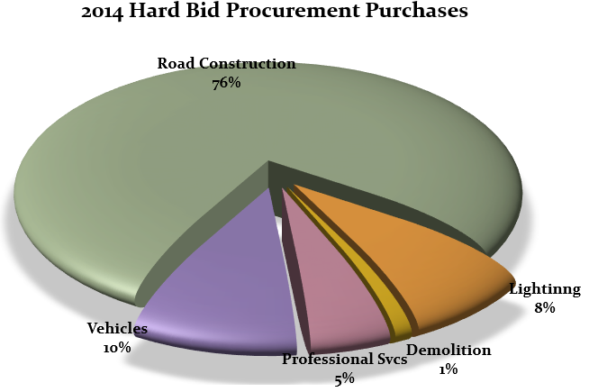
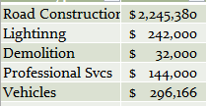
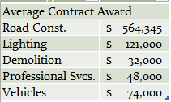

Slide 5
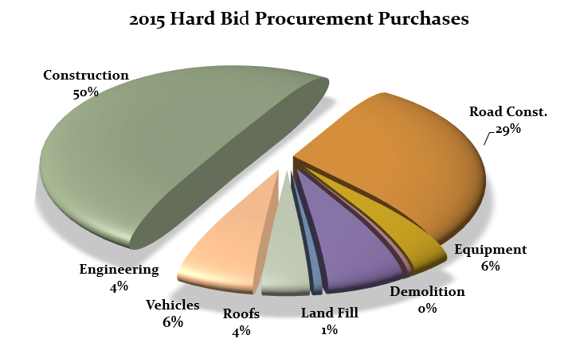
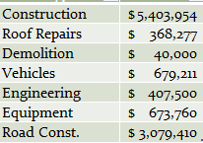
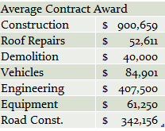

Slide 6
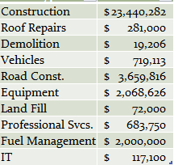
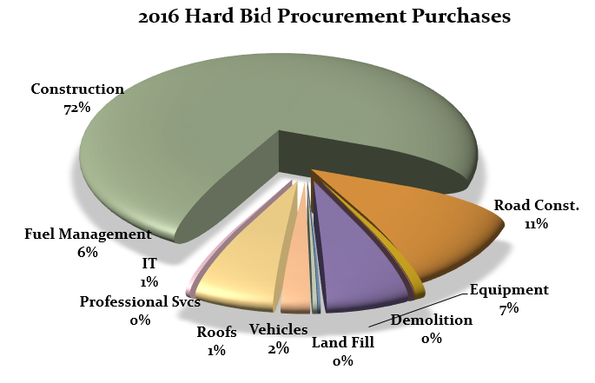
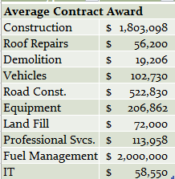

Slide 7
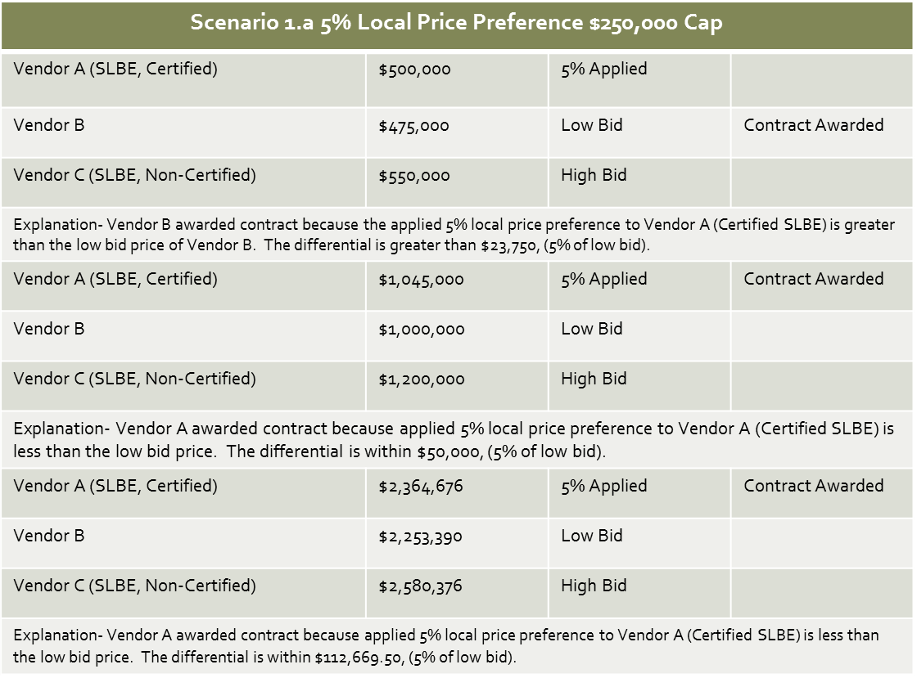

Slide 8
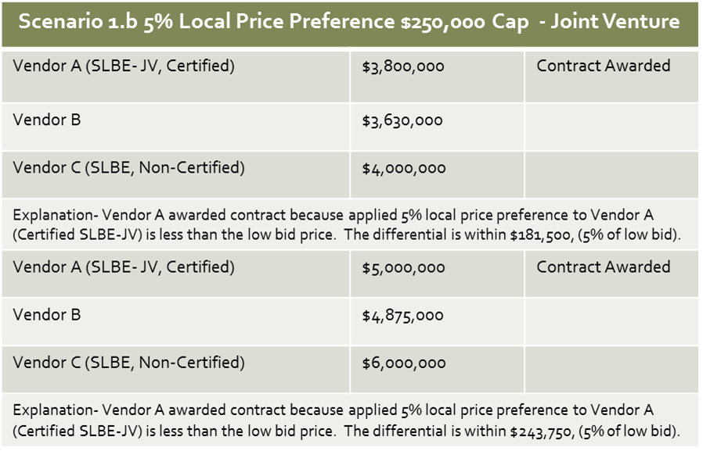

Slide 9
SMALL LOCAL BUSINESS ENTERPRISE PROGRAM
MAXIMIZE THE USE OF SMALL LOCAL BUSINESSES IN THE COMPETITIVE
COUNTY PROCUREMENT CONTRACT AWARD PROCESS

Slide 10
Contact Information
Director: Dr. James Bumpus
Administrative office located at:
700 Poplar Street
Macon, GA 31201
P: (478) 803-0366
C: (478) 951-2192
jbumpus@maconbibb.us
http://www.maconbibb.us/small-business-affairs/

